Slide 1

rSNAPed : RNA Sequence to NAscent Protein Experiment Designer
Luis Aguilera, William Raymond, Brooke Silagy, Tatsuya Morisaki, Brian Munsky.
Notes:
Today I am going to talk to you about the work Luis and I have been doing lately. We have been working on simulating cell data of single-cell mRNA translation.

Slide 2

rSNAPed : image processing pipeline
Fully Automated – Large Scale Usability – Experimental design .
1
2
3
4
Segmentation
*cellpose
Tracking
**trackpy
Quantification
Classification
5
Simulated Data
*Stringer, C., Wang, T., Michaelos, M. et al. Cellpose: a generalist algorithm for cellular segmentation. Nat Methods 18, 100–106 (2021).
**Allan, Daniel B., Caswell, Thomas, Keim, Nathan C., van der Wel, Casper M., & Verweij, Ruben W. (2021, April 13). soft-matter/trackpy: Trackpy v0.5.0 (Version v0.5.0). http://doi.org/10.5281/zenodo.4682814
Notes:
In rSNAPed, the simulated software, we are implementing a fully automated pipeline that allows the analysis of single-molecule data sets. rSNAPed models single-mRNA translation using observable fluorescence and mechanistic interpretation.
Segmentation is the first step of the process. Cellpose is a cellular segmentation algorithm written in Python. It is an open-source package that is freely available. It allows us to transform raw simulated image data into interpretable data that we can apply to our experiments. The first step in image segmentation is to segment the images into cell bodies. This is relatively easy when the cells are sufficiently separated from each other, but can become more difficult if the cells are tightly packed together. A mask is then created around the cell bodies with pixels, and all of the pixels are trying to point towards the center. All of these pixels conglomerate as one cell.
The second part of the image processing pipeline includes Trackpy, a python package that tracks dots. It allows us to track fluorescent antibody-based probes that are bound to nascent proteins on single-RNA cells only visible by their beacons of light. The image is represented as a numpy array of intensities. We end up with a field of tracked particles. Results are given as data frames that can be easily saved.
After tracking the spots, we quantify the data by comparing the intensity distributions. We can quantify intensity in every spot. This is done in one method by using disk and donut. You take a tracked spot, and travel a disk and a donut outside of the spot. After drawing a donut outside of the spot, you can calculate the mean intensity of donut and the intensity in the disk.
We then classify these spot intensities based on their color channels. The images have three different color channels: red, blue, and green. We can classify the spots through either single color channels of red, blue, and green, or the combinations of them.
Every part of this pipeline is connected to the simulated cell. It allows us to generate large amounts of data to fully automate the pipeline.

Slide 3




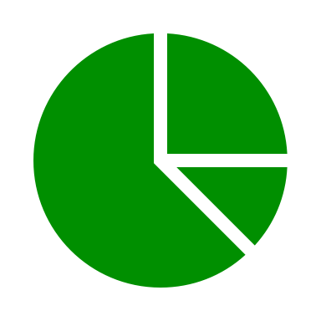

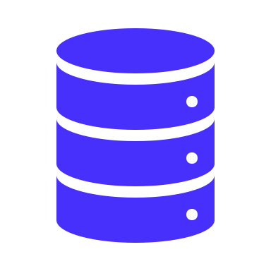





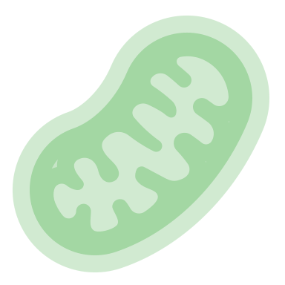




rSNAPed : image processing pipeline
Data input
Automated Processes
Output
Image Processing
Stochastic Simulations
Model inference
x₂
Gene construct
x₁
x₃
Segmentation
Spot detection
and tracking
Quantitative
data selection
Simulated images
Simulated data
Experimental data and model interpretation
Microscope images
*Stringer, C., Wang, T., Michaelos, M. et al. Cellpose: a generalist algorithm for cellular segmentation. Nat Methods 18, 100–106 (2021).
**Allan, Daniel B., Caswell, Thomas, Keim, Nathan C., van der Wel, Casper M., & Verweij, Ruben W. (2021, April 13). soft-matter/trackpy: Trackpy v0.5.0 (Version v0.5.0). http://doi.org/10.5281/zenodo.4682814
Notes:
In rSNAPed, the simulated software, we are implementing a fully automated pipeline that allows the analysis of single-molecule data sets. rSNAPed models single-mRNA translation using observable fluorescence and mechanistic interpretation.
Segmentation is the first step of the process. Cellpose is a cellular segmentation algorithm written in Python. It is an open-source package that is freely available. It allows us to transform raw simulated image data into interpretable data that we can apply to our experiments. The first step in image segmentation is to segment the images into cell bodies. This is relatively easy when the cells are sufficiently separated from each other, but can become more difficult if the cells are tightly packed together. A mask is then created around the cell bodies with pixels, and all of the pixels are trying to point towards the center. All of these pixels conglomerate as one cell.
The second part of the image processing pipeline includes Trackpy, a python package that tracks dots. It allows us to track fluorescent antibody-based probes that are bound to nascent proteins on single-RNA cells only visible by their beacons of light. The image is represented as a numpy array of intensities. We end up with a field of tracked particles. Results are given as data frames that can be easily saved.
After tracking the spots, we quantify the data by comparing the intensity distributions. We can quantify intensity in every spot. This is done in one method by using disk and donut. You take a tracked spot, and travel a disk and a donut outside of the spot. After drawing a donut outside of the spot, you can calculate the mean intensity of donut and the intensity in the disk.
We then classify these spot intensities based on their color channels. The images have three different color channels: red, blue, and green. We can classify the spots through either single color channels of red, blue, and green, or the combinations of them.
Every part of this pipeline is connected to the simulated cell. It allows us to generate large amounts of data to fully automate the pipeline.

Slide 4


Software development
Source code
User Interface
Open source – written on python
OOP / 20 Classes
Github & PIP
Jupyter notebooks
Google Colab / Linux cluster
HTML Documentation - Sphynx
OOP : Object Oriented Programming
PIP : Package Installer for Python
Notes:
rSNAPed is an open source code written in python. It uses object oriented programming split into 20 classes. These 20 classes involve calculating intensity and tracking to create the mask in cell pose. For every class, the documentation tells us the parameters we need and the output. Github & PIP is where the code is posted.
The code can be accessed through multiple user interfaces. Jupyter is one interface which can be done on the user's local computer. This requires access to the GIT repository. With Google Colab, the code is free and readily available to multiple users while still allowing Luis to continue working on new versions.
The code can also be accessed through the CSU Cluster. CSU uses a grid engine cluster with Linux as it's operative system. What we've done is create a conda environment with the cluster that allows us to run rSNAPed with required packages and their compatible versions.
On a local computer, depending on the parameter variations, the code can take anywhere from 10 minutes up to multiple hours to run. Using the cluster allows us to run multiple versions of the code at the same time at different parameters. This allows us to generate large data sets that would otherwise take a long time to create.
We are working with the documentation output using sphinx.

Slide 5






Automation
Non-automated pipeline
selected parameter(s)
Target (#spots)
tuning
parameters
Image(s)
large process(es)
Segmentation/tracking
Process parameters
Data

Slide 6



Automation
Automated Image processing pipeline
100s cells
1000s spots
rsnaped-pipeline-CLI
automated data management
Segmentation
1
Tracking
2
Quantification
¹ Automatic parameter tuning
² Automatic decision taking if an analysis fails
CLI : Command Line Interface

Slide 7
Automation
Programming paradigms
¹Meta-optimization
Super-classes
Meta-optimizer
Optimizer
rsnaped-Pipeline
Actual problem(s)
Segmentation
Tracking
Quantification
¹Mercer, R.E.; Sampson, J.R. (1978). "Adaptive search using a reproductive metaplan". Kybernetes. 7 (3): 215–228. doi:10.1108/eb005486.

Slide 8



Simulated cell
Simulated data sets
Fast generation of large data sets
Testing and improving pipeline
Testing new hypotheses in silico
Real Image
Simulated Image
Notes:
With simulated data sets, we are implementing multiple experimental designs to test the limits of current single-molecule gene expression technology. We are looking for specific challenges from differing parameters that can bias the measurements. Some of these parameters we are adjusting include the diffusion coefficient, number of spots, number of cells, and simulated time in seconds. We can also adjust the mask selection method and intensity calculation method.
By gaining information from these large data sets, we can improve the simulated pipeline to generate more accurate data as well as test new hypothesis with the simulation before performing it in the lab.
This is really beneficial, because we can run a whole experiment pipeline, generate a lot of simulated data and test if a hypothesis makes sense. If it does make sense, you can go on to the lab and do the experiment. This ability to test new hypotheses in silico saves a lot of time and resources before setting up an experiment in the lab.

Slide 9
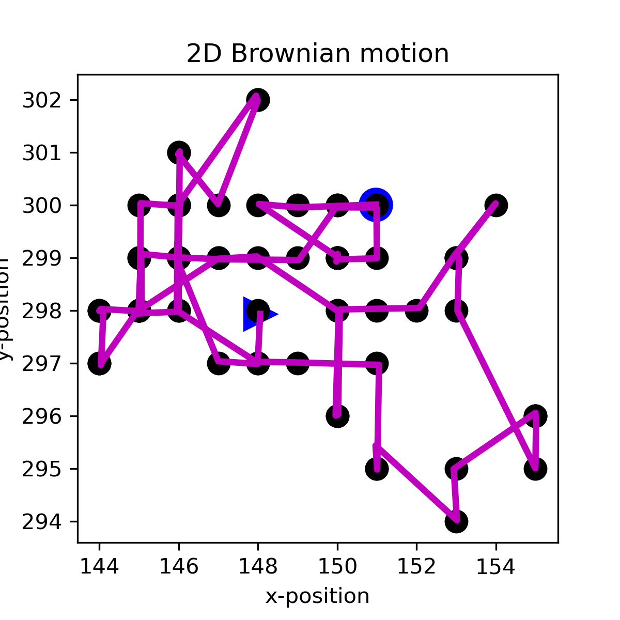
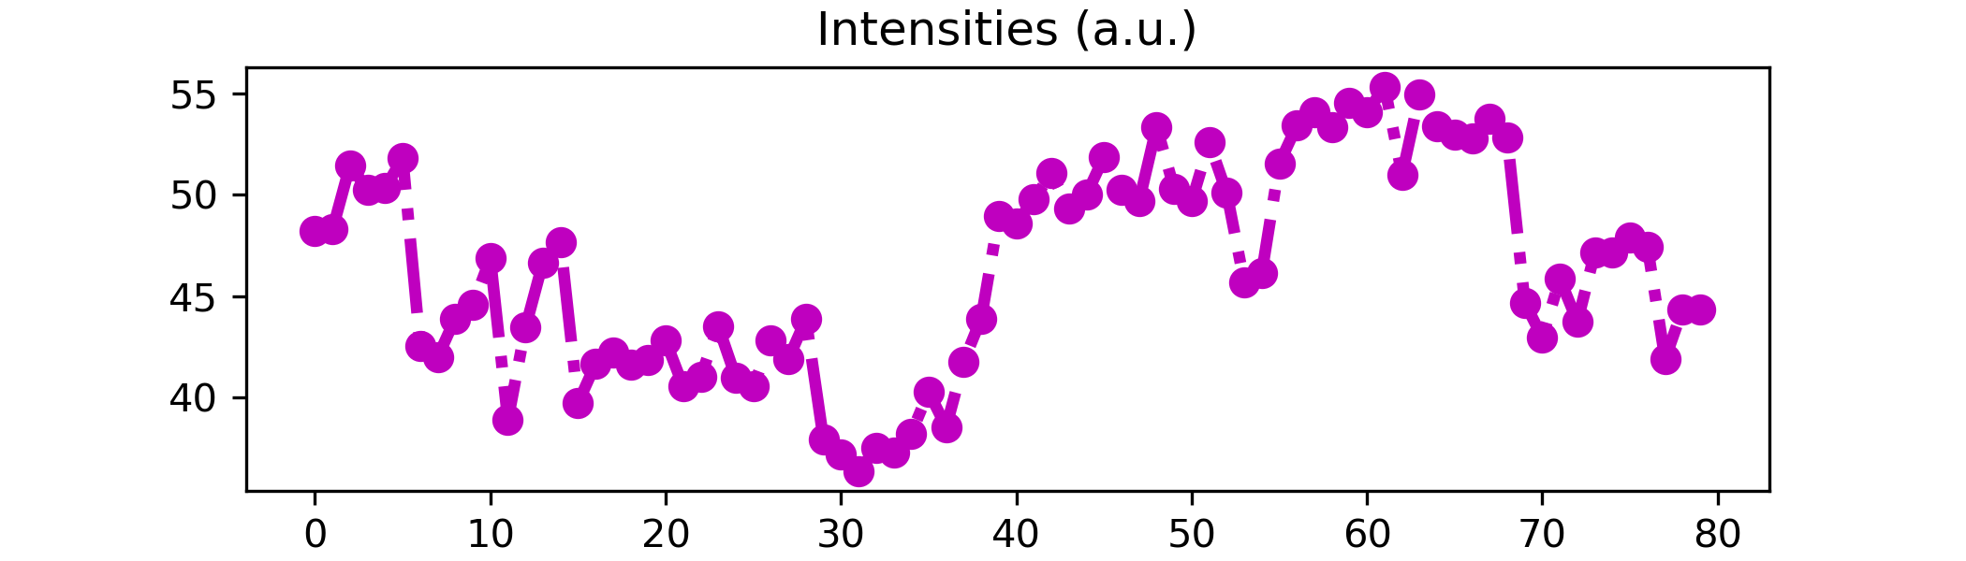
Simulated cell
Simulated spots
2D Brownian Motion
Intensity ¹rSNAPsim – TASEP
TASEP : Total Asymmetric Exclusion Process
¹Aguilera, L., Raymond, W., .., Munsky, B. (2019). Computational design and interpretation of live-cell, single-RNA translation experiments. PLoS Computational Biology 15 (10).
Notes:
We have two different processes to create every spot in the simulated cell, movement and intensity. The movement of the particle spots is simulated with Brownian motion. This movement is making random trajectory decisions in the x or y position.
The intensity of every spot is increasing or decreasing based on th rSNAPsim software that Will is working on. Total assymetric exclusion process or TASEP is what we are using in the software. It's a kind of model that describes the movement of ribosomes in the RNA. The ribosomes are binding to the RNA and are moving in the RNA. The moving ribosome has some volume and mass, and it cannot pass another ribosome. It's essentially an exclusion process that takes into account the mass and volume of a specific thing, in this case a ribosome, that is in front of another ribosome.

Slide 10
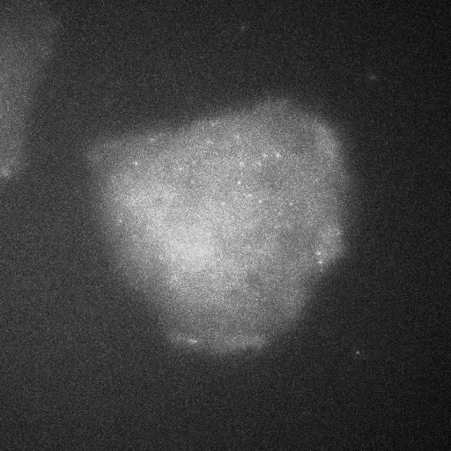
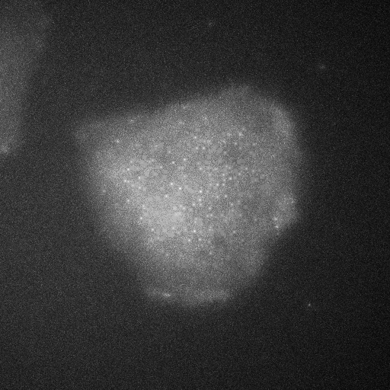
Simulated cell
Simulating different particle concentrations
20 simulated spots
200 simulated spots
Notes:
This is showing the same model, with different parameters of the increasing and decreasing intensity that we would normally simulate with rSNAPsim. The cell of the left shows 20 simulated spots, and the cell on the right is showing 200 simulated spots. One thing we found with the code initially is it tended to overestimate the number of spots when we set the spot parameter low, and underestimate the number of spots when the spot parameter was high.

Slide 11
Implementation
Examples using jupyter notebooks
Documentation
Generating simulated data
Pipeline implementation in live-cells
Pipeline implementation in fixed-cells FISH

